Slide 1
SOM / KOHONEN MAPS
Kohonen’s SOM is a widely-used ANN model based on the idea of
self-organized or unsupervised learning (Kohonen, 2001).

Slide 2
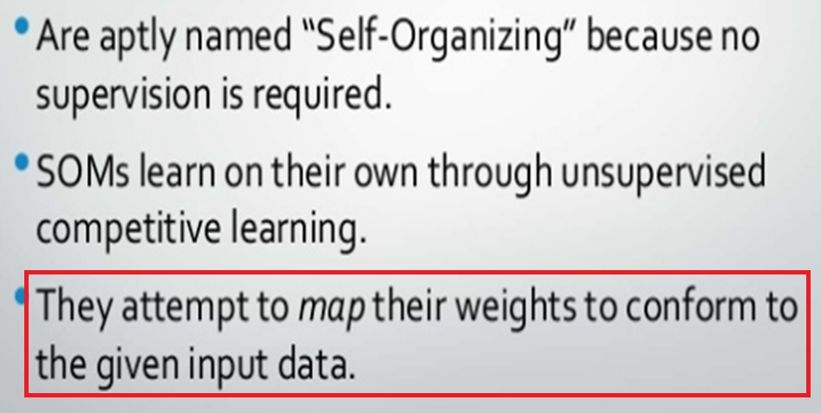

Slide 3
The basic idea of competitive learning was introduced in the early 1970s.
In the late 1980s, Teuvo Kohonen introduced a special class of artificial neural networks called self-organizing feature maps based on competitive learning..

Slide 4
Competitive learning
In competitive learning, neurons compete among themselves to be activated.
While in Hebbian learning, several output neurons can be activated simultaneously, in competitive learning, only a single output neuron is active at any time.
The output neuron that wins the “competition” is called the winner-takes-all neuron.

Slide 5
Self Organizing map (SOM), sometimes also called a Kohonen map use
unsupervised,
competitive learning
to produce
low dimensional,
discretized representation of high dimensional data,
while simultaneously preserving similarity relations between the presented data items.
Such low dimensional representation is called a feature map, hence map in the name.

Slide 6

Among numerous neural network architectures, particularly interesting architecture was introduced by Finish Professor Teuvo Kohonen in the 1980s
The competitive learning process is realized in this kind of networks.

Slide 7
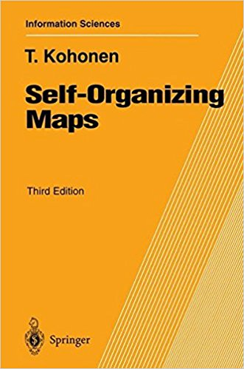

Slide 8
In Unsupervised training, networks learn to from their own classifications of the training data without external help.
The main difference between Self-organizing networks and conventional models is that the correct output cannot be defined a priori, and therefore a numerical measure of the magnitude of the mapping error cannot be used.
Assume that class membership is broadly defined by the input patterns sharing common features, and that the network is able to identify those features across the range of input patterns.

Slide 9
One particularly interesting class of unsupervised system is based on competitive learning, in which the output neurons compete amongst themselves to be activated, with the result that only one is activated at any one time.
This activated neuron is called a winner-takes all neuron or simply the winning neuron.
The result is that the neurons are forced to organise themselves so such a network is called a Self Organizing Map (SOM).

Slide 10

Massive document collections can be organized using a SOM. It can be optimized to map large document collections while preserving much of the classification accuracy

Slide 11
Self Organization
The unsupervised weight adapting algorithms are usually based on some form of global competition between the neurons.
Applications of self-organizing networks are:

Slide 12
S.O. Applications
Clustering
Vector quantization
Dimensionality reduction
Feature Extraction

Slide 13
clustering: the input data may be grouped in `clusters' and the data processing system has to find these inherent clusters in the input data.
vector quantisation: this problem occurs when a continuous space has to be discretised. The input of the system is the n-dimensional vector x, the output is a discrete representation of the input space. The system has to find optimal discretisation of the input space.
dimensionality reduction: the input data are grouped in a subspace which has lower dimensionality than the dimensionality of the data. The system has to learn an “optimal” mapping
feature extraction: the system has to extract features from the input signal. This often means a dimensionality reduction as described above.

Slide 14
Types of Self-Organizing Networks
Learning Vector Quantization (LVQ)
Kohonen Maps
Principal Components Networks (PCN)
Adaptive Resonance Theory (ART)

Slide 15
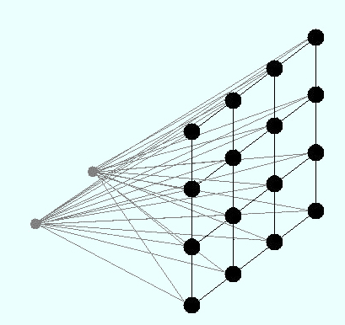

Slide 16
Kohonen Maps

Slide 17
Kohonen Maps
The input x is given to
all the units at the same
time

Slide 18
Kohonen Maps
The weights
of the winner unit
are updated
together with the weights of
its neighborhoods

Slide 19
Feature-mapping Kohonen model

Slide 20
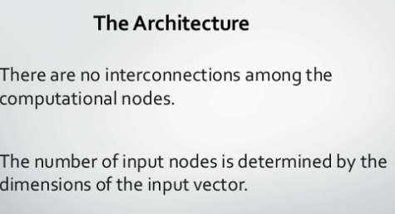

Slide 21
KOHENON MAPS :
The basic units are neurons, and they are organized into two layers: the input layer and the output layer (also called the output map).
All of the input neurons are connected to all of the output neurons, and these connections have strengths, or weights, associated with them.
The output map is a one/two-dimensional grid of neurons, with no connections between the units.

Slide 22
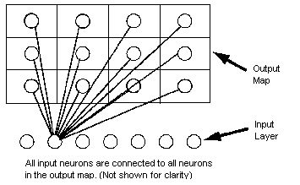
a one dimensional map will just have a single row (or a single column) in the computational layer.

Slide 23
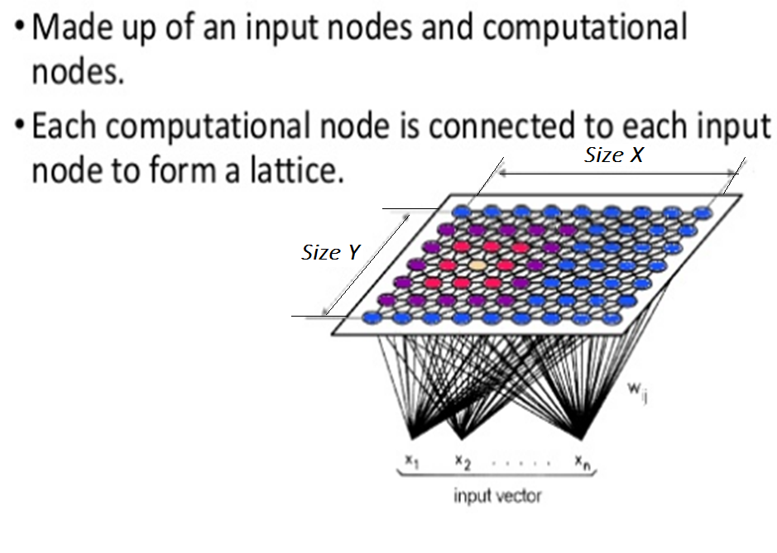

Slide 24
Initially, all weights are random.
Upon giving input ,weights of winning node along with those of other nearby units, collectively referred to as a neighborhood are adjusted
All of the input records are shown, and weights are updated accordingly.
This process is repeated many times until the changes become very small.
As training proceeds, the weights on the grid units are adjusted so that they form a two-dimensional "map" of the clusters (hence the term self-organizing map).
When the network is fully trained, records that are similar should be close together on the output map, whereas records that are vastly different will be far apart.

Slide 25
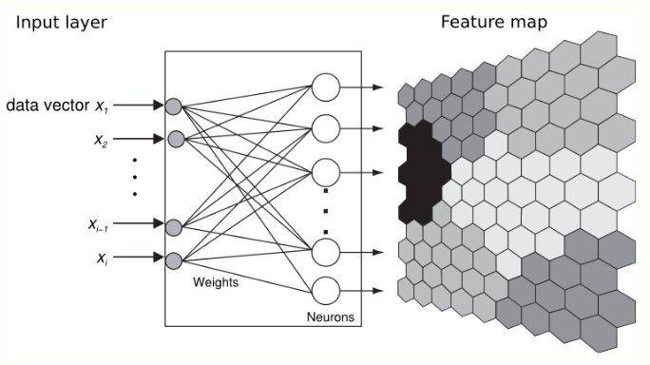

Slide 26
Initial random weights
100 nodes
W(2,j)
W(1,j)

Slide 27
Network after 100 iterations
W(2,j)
W(1,j)

Slide 28
Network after 1000 iterations
W(2,j)
W(1,j)

Slide 29
Network after 10,000 iterations
W(2,j)
W(1,j)

Slide 30
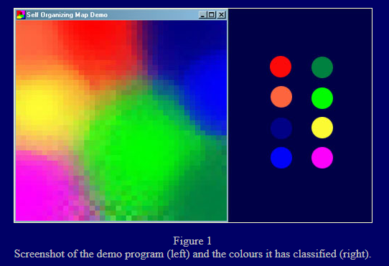

Slide 31
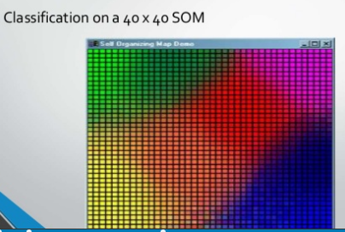
Each cell represents a node in the lattice.
The SOM shown in Figure has a default lattice size of 40 X 40.
Each node in the lattice has three weights, one for each element of the input vector: red, green and blue.
Each node is represented by a rectangular cell when drawn to your display.
Figure shows the cells rendered with black outlines so you can clearly see each node.

Slide 32
A SOM does not need a target output to be specified unlike many other types of network.
Instead, where the node weights match the input vector, that area of the lattice is selectively optimized to more closely resemble the data for the class the input vector is a member of.
From an initial distribution of random weights, and over many iterations, the SOM eventually settles into a map of stable zones.
Each zone is effectively a feature classifier, so you can think of the graphical output as a type of feature map of the input space.
The blocks of similar colour represent the individual zones. Any new, previously unseen input vectors presented to the network will stimulate nodes in the zone with similar weight vectors.

Slide 33
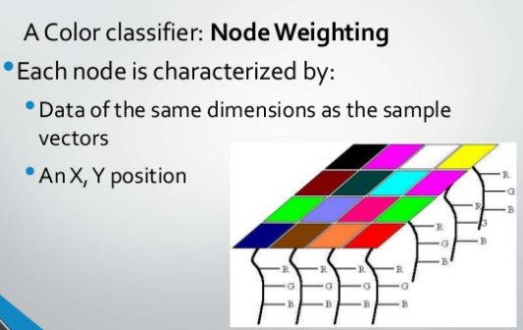

Slide 34
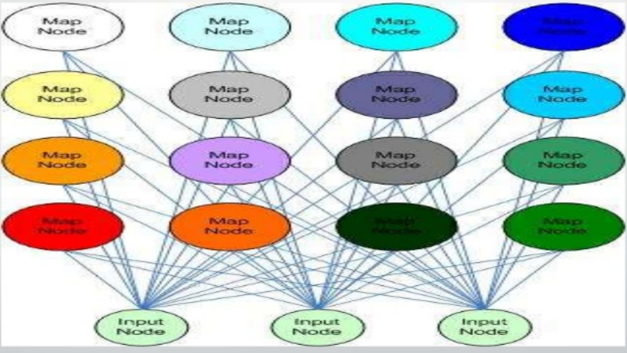

Slide 35
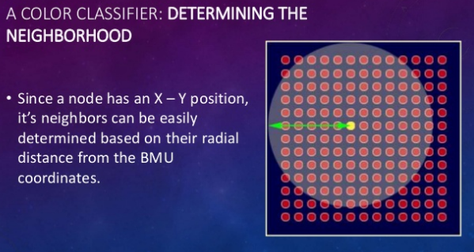
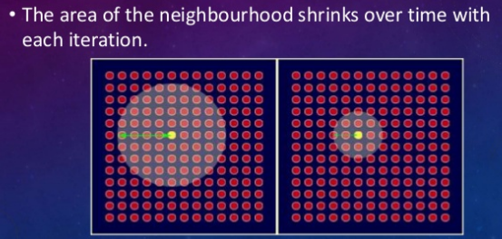

Slide 36
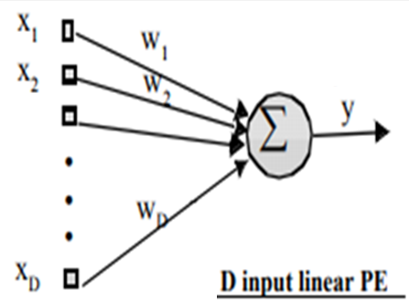

Inner product is computed as product of the length of vectors times the cosine of angle between them to produce scalar y

Slide 37

A small y means that the input is almost perpendicular to w (cosine of 90 degrees is 0), i.e. x and w are far apart.
So the magnitude of y measures similarity between the input x and the weight w using the inner product as the similarity measure.
This is a very powerful interpretation.

Slide 38
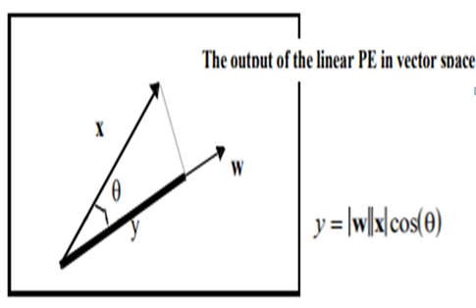
Assuming normalized inputs and weights, large ‘y’ means that input ‘x’ is close to the direction of weight vector, i.e. x is in neighborhood of w

Slide 39
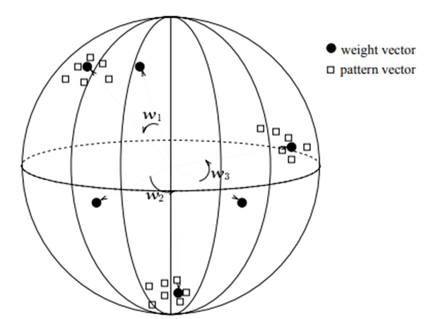
Example of clustering in 3D with normalised vectors, which lie on the unity sphere.
Weights are rotated towards the centres of gravity of all three different input clusters

Slide 40
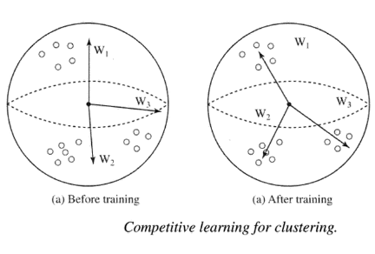

Slide 41
Instead of finding nearness by inner product( calculating y=wx), distance between weight and input is calculated, and weight vector is rotated towards the input, means weight is made closer to INPUT, i.e
Weights of the winner are updated

Slide 42
The overall effect of the competitive learning rule resides in moving the synaptic weight vector W_{j} of the winning neuron j towards the input pattern X. The matching criterion is equivalent to the minimum Euclidean distance between vectors.
The Euclidean distance between a pair of n-by-1 vectors X and W_{j} is defined by
where x_{i} and w_{ij} are the i^{th} elements of the vectors X and W_{j}, respectively.

Slide 43
In the Kohonen network, a neuron learns by shifting its weights from inactive connections to active ones. Only the winning neuron and its neighbourhood are allowed to learn.
If a neuron does not respond to a given input pattern, then learning cannot occur in that particular neuron.
The competitive learning rule defines the change Δw_{ij} applied to synaptic weight w_{ij} as
where x_{i} is the input signal and α is the learning rate parameter.

Slide 44
Training steps
Each node's weights are initialized.
A vector is chosen at random from the set of training data and presented to the lattice.
Every node is examined to calculate which one's weights are most like the input vector. The winning node is commonly known as the Best Matching Unit (BMU).
The radius of the neighbourhood of the BMU is now calculated. This is a value that starts large, typically set to the 'radius' of the lattice, but diminishes each time-step. Any nodes found within this radius are deemed to be inside the BMU's neighbourhood.

Slide 45
Weights of BMU and neighbouring nodes of the winner node are adjusted to make them more like the input vector.
The closer a node is to the BMU, the more its weights get altered.
Repeat step 2 onwards for N iterations.

Slide 46
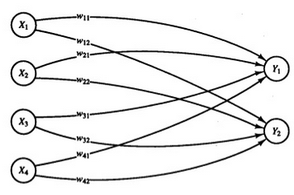
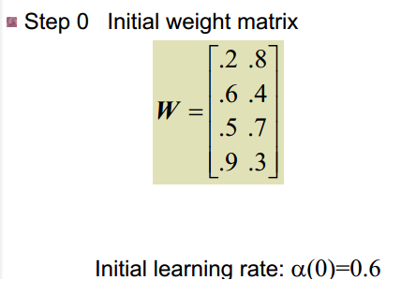

Slide 47
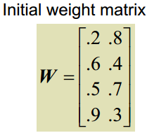
Step 4: Input vector s(1) is closest to o/p node 2, so j=2 is winner node and weights associated with node 2 are updated

Slide 48
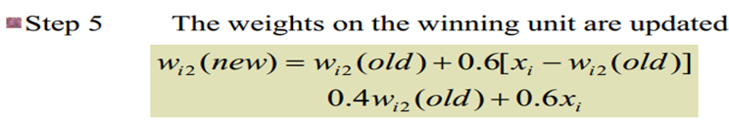
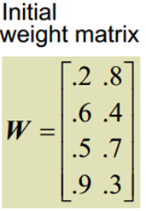
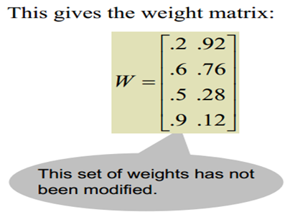
Calculate new weights
Remember it is not absolute difference Input is 1100
w₁₂ and w₂₂ have increased, so distance will decrease
w₃₂ and w₄₂ decreased so distance will increase

Slide 49
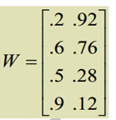

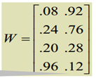

Calculate new weights
Input 0 0 0 1
w₁₁ and w₂₁ and w₃₁
have decreased
w₄₁ increased(distance between 1 and weight decreases),

Slide 50



Only W₁₂ increased and all others decreased Input 1 0 0 0

Slide 51
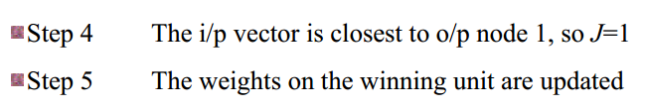
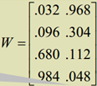
w₁₁ and w₂₁ decreased
w₄₁ and w₃₁ increased,
Input 0 0 1 1

Slide 52

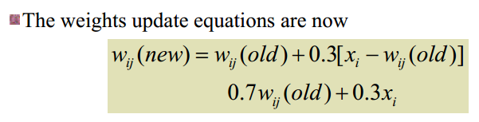
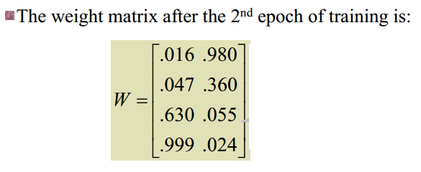
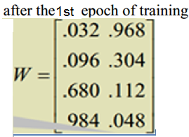

Slide 53
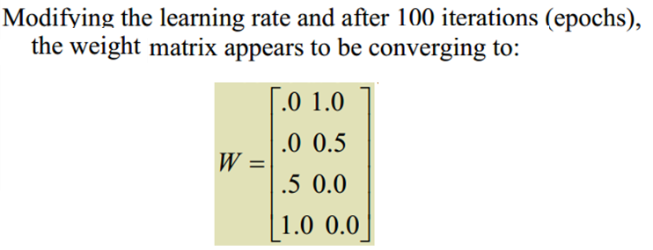
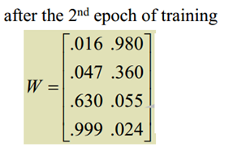
In first iteration
After 100 iterations, distance from node 2 has decreased from 0.98 to 0.25, and distance from node 1 has increased from 1.86 to 3.25

Slide 54
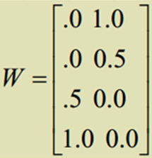
s(1)=(1,1,0,0)
1100(s1) is in cluster 2
weights do not change ,s1 is in cluster 2

Slide 55
Winner is Node 1,weights do not change( α too small), input 2 is in cluster 1

Slide 56
Winner is Node 2,weights do not change, input 3 is in cluster 2

Slide 57
Winner is Node 1,weights do not change, input 4 is in cluster 1

Slide 58

Avg of vectors in c1 : 0,0,0.5,1
Avg of vectors in c2 : 1,0.5,0,0

Slide 59
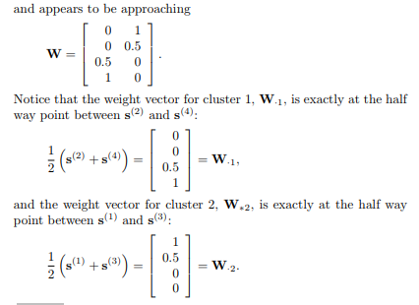

Slide 60
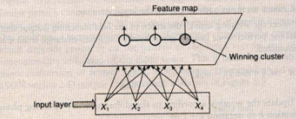
A Kohonen SOM is used to cluster four vectors given by :
(1,1,1,0) ; ( 0,0,0,1) ; (1,1,0,0) ; ( 0,0,1,1)
The maximum number of clusters to be formed is 3. learning rate is given by
α(0)=0.3
α(t+1)=0.2α(t)

Slide 61
Initial Weight matrix is
Step 1: begin training
Step 2: For first input vector x = (1,1,1,0) do steps 3-5
Step 3 :
L(1)=(1-0.2)² + (1-0.3)² + (1-0.5)² + (0-0.1)² = 1.39
L(2)=(1-0.4)² + (1-0.2)² + (1-0.3)² + (0-0.1)² =1.5
L(3)=(1-0.1)² + (1-0.2)² + (1-0.5)² + (0-0.1)² =1.71
Step 4 : Input Vector is closest to output node 1. Thus NODE 1 is winner. Weights for node 1 is to be updated
Step 5 : weights on winning node are updated

Slide 62
First input vector x = (1,1,1,0)

Slide 63
Step 2: For Second input vector x = (0,0,0,1) do steps 3-5
Step 3 :
L(1)=(0-0.44)² + (0-0.51)² + (0-0.65)² + (1-0.37)² =1.2731
L(2)=(0-0.4)² + (0-0.2)² + (0-0.3)² + (1-0.1)² =1.1
L(3)=(0-0.1)² + (0-0.2)² + (0-0.5)² + (1-0.1)² =1.11
Step 4 : Input Vector is closest to output node 2. Thus NODE 2 is winner. Weights for node 2 is to be updated
Step 5 : weights on winning node 2 are updated

Slide 64
Second input vector x = (0,0,0,1)

Slide 65
Step 2: For Third input vector x = (1,1,0,0) do steps 3-5
Step 3 :
L(1)=(1-0.44)² + (1-0.51)² + (0-0.65)² + (0-0.37)² =1.1131
L(2)=(1-0.28)² + (1-0.14)² + (0-0.21)² + (0-0.37)² =1.439
L(3)=(1-0.1)² + (1-0.2)² + (0-0.5)² + (0-0.1)² =1.71
Step 4 : Input Vector is closest to output node 1. Thus NODE 1 is winner. Weights for node 1 is to be updated
Step 5 : weights on winning node 1 are updated

Slide 66
Third input vector x = (1,1,0,0)

Slide 67
Step 2: For Fourth input vector x = (0,0,1,1) do steps 3-5
Step 3 :
L(1)=(0-0.608)² + (0-0.657)² + (1-0.455)² + (1-0.259)² =1.647
L(2)=(0-0.28)² + (0-0.14)² + (1-0.21)² + (1-0.37)² =1.119
L(3)=(0-0.1)² + (0-0.2)² + (1-0.5)² + (1-0.1)² =1.11
Step 4 : Input Vector is closest to output node 3. Thus NODE 3 is winner. Weights for node 3 is to be updated
Step 5 : weights on winning node 3 are updated

Slide 68
Fourth input vector x = (0,0,1,1)
EPOCH 1 is complete. Reduce the learning rate :
α(t+1)=0.2 α(t)=0.2(0.3)=0.06 and repeat from start for new epochs until Δw becomes steady for all input patterns

Slide 69
END

